Slide 1
Introduction to National Reference Laboratory (NRL)

Slide 2
Who are we?
Introduction to NRL
Scientific, not-for-profit organisation based in Melbourne, Australia
Exist to promote the quality of testing for infectious diseases, globally
A division of St Vincent’s Institute of Medical Research (SVI)
We partner with
Australian government – DFAT, TGA, DoH
Australian partners – Kirby, Flinders University PoC, PDI, NMI, CSIRO, AIHSP
International partners – WHO, USA CDC, FIND, Global Fund, ASM, ASLM, AATM
Ministries of Health
Blood services
Diagnostic laboratories
Test Kit manufacturers

Slide 3
Our achievements
Introduction to NRL
A designated WHO Collaborating Centre for Diagnostics and Laboratory Support for HIV and AIDS and Other Blood-borne Infections
Authorised WHO Prequalification Evaluation Laboratory
Certified for Quality Management to Management Standard AS/NZS ISO 9001 (originally certified in 1998)
Accredited as a Medical Testing Laboratory to Laboratory Accreditation Standard ISO/IEC 15189 (first accredited in 1997)
Accredited as EQAS Provider to ISO 17043 (first accredited in 2001)
Licensed as following Good Manufacturing Practice under the Code of Good Manufacturing Practice - Human Blood & Tissue:2013 (originally granted in 1999)

Slide 4
What services do we provide?

Slide 5
1. Quality Control Program
Our services
International run control program for serology and molecular infectious disease testing
Collaborate with DiaMex (Heidelberg, Germany) as QC manufacturer
Proprietary QC software called EDCNet
QConnect concept for monitoring QC results and acceptance limits
World leaders in infectious disease QC with 20+ peer review papers
Click to see more!

Slide 6
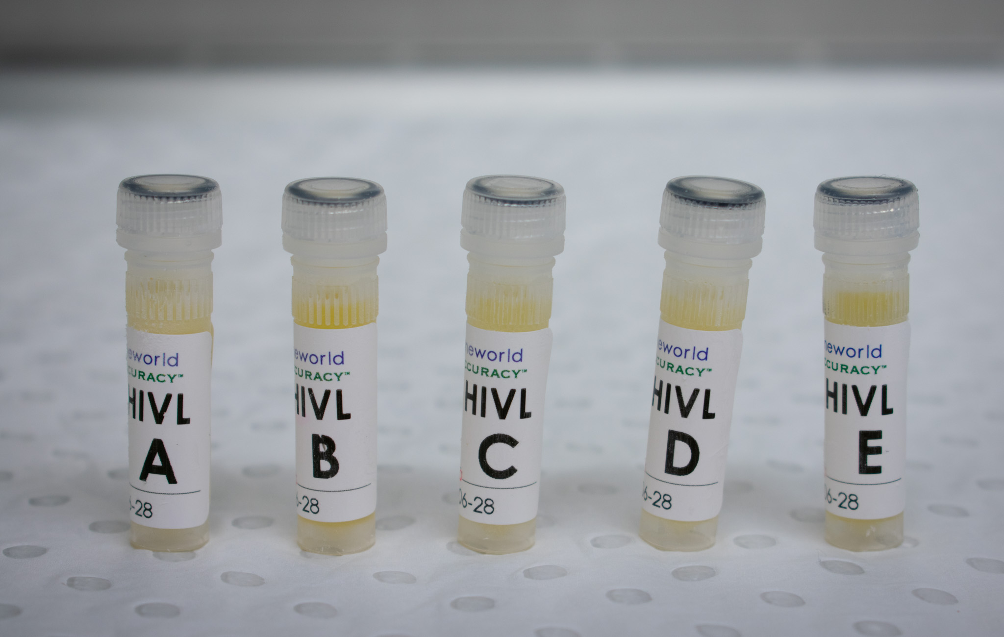
2. External Quality Assessment Schemes
Our services
Serology and molecular programs for infectious diseases
Over 2,000 labs in 70+ countries including Caribbean and South America
ISO 17043 accredited
Partner with OneWorld Accuracy (Vancouver, Canada) for use of OASYS software
Usually, three test events per year with 5 samples per test event
Click to see more!

Slide 7
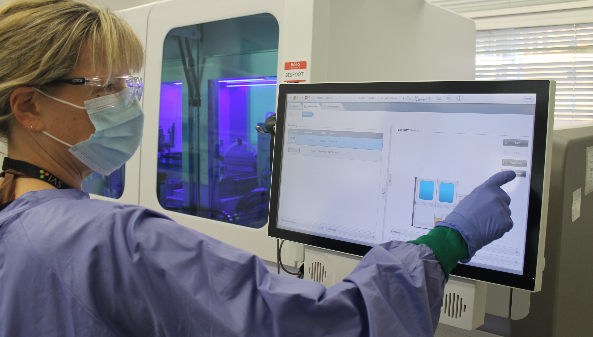
3. Reference testing and donor screening
Our services
Reference Testing for blood-borne infections
TGA-licensed screening for HIV, HTLV, HCV, HBV and Syphilis for specimens collected from both living and cadaver donors
Contract testing in the form of projects, clinical trials and collaborations for epidemiological purposes and assessment of new IVDs
Batch Release Testing Services
Click to see more!

Slide 8
4. Research and Development
Our services
Predominantly focused on HTLV
Developed an HTLV Proviral load quantitative NAT
Supports Australian government “Longitudinal study” of First Nations peoples
Support PAHO Workshop for the implementation of HTLV testing in Argentina
Developed Australian clinical guidelines on HTLV
Support the development of samples used in NRL QA services
Click to see more!

Slide 9
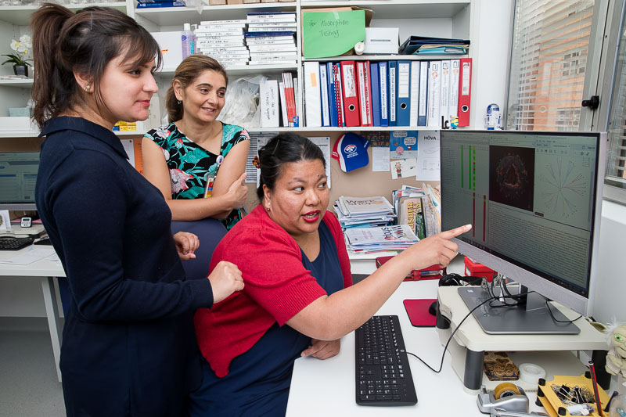
5. Consulting & Training
Our services
Technical training or advice to troubleshoot and address specific knowledge gaps, or design and/or verify a new process or program.
Performing capacity assessments and gap analysis
Design and delivery of customised training programs
Development of guidance documents in collaboration with partners such as the World Health Organization
Click to see more!

Slide 10
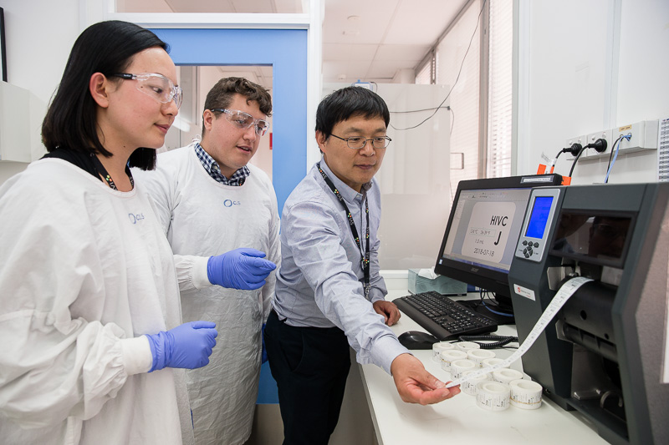
6. Test Kit Evaluations
Our services
WHO Prequalification Evaluation laboratory
Perform evaluations for TGA and support other governments
Provide evaluation services to test kit manufacturers including validation of sample types, clinical trials
Multiple peer-review publications on SARS-CoV-2 test kit evaluations
Batch testing
Click to see more!

Slide 11
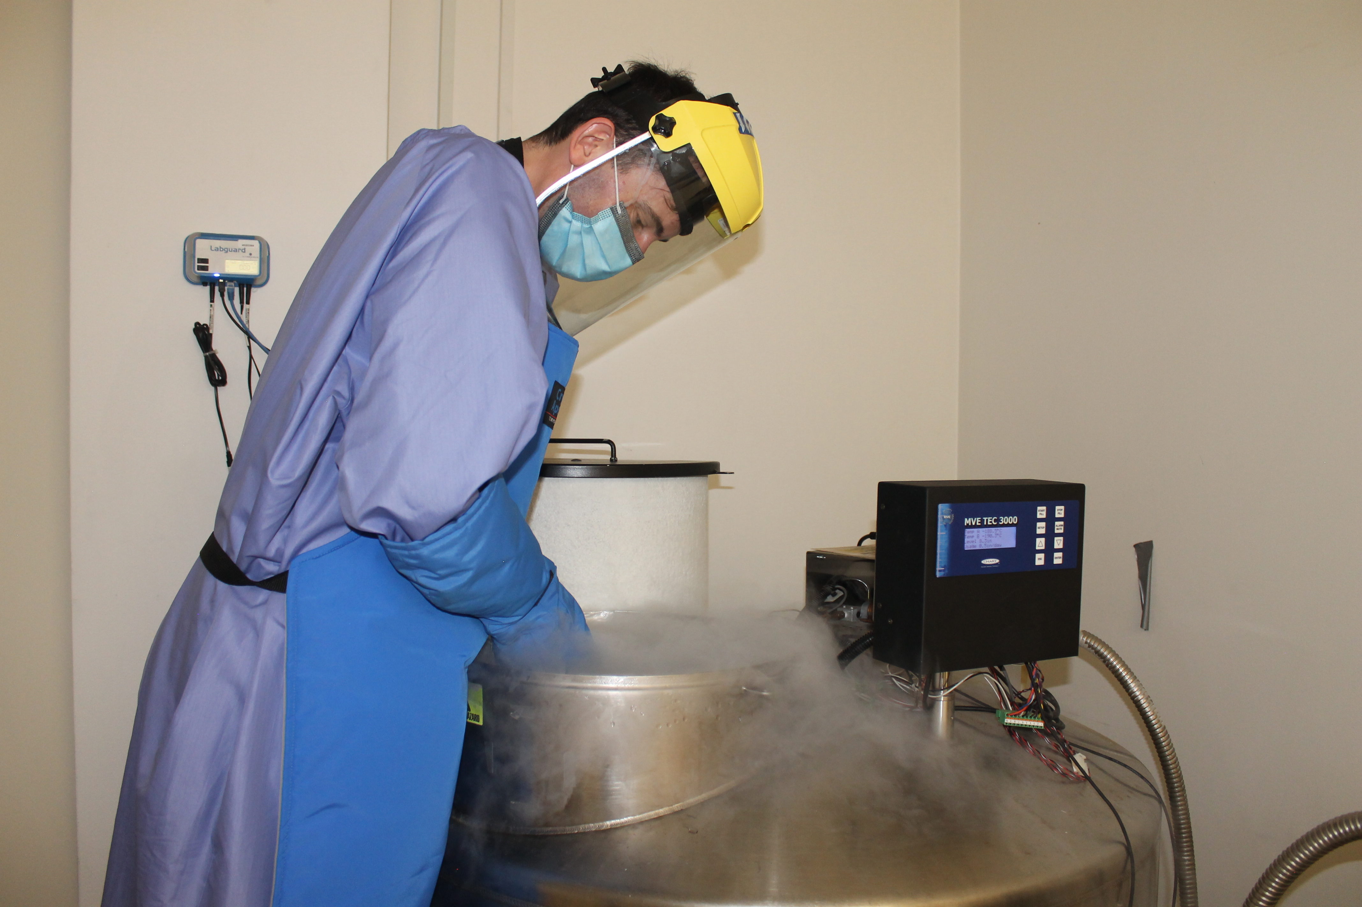
7. Biobank & Biorepository
Our services
SVI initiative to support research in the precinct
Repository for research groups, clinical trials organisations and others requiring contract storage of biological samples
More than 22,000 specimens from 600+ participants and growing
Ethics for sample collection and use
NRL Sample bank has over 100,000+ disease state samples
Well characterised and documented
Click to see more!

Slide 12
Any questions? Get in touch.

